Slide 1
Geospatial concepts
Geospatial data
Vector data
Raster data
Coordinate reference system (CRS)
Geodetic datum
Projection
Data for this workshop

Slide 2

Geospatial Data
Data that has a geographic component to it. The component can be X and Y coordinates, address, city, or zip code.

Slide 3
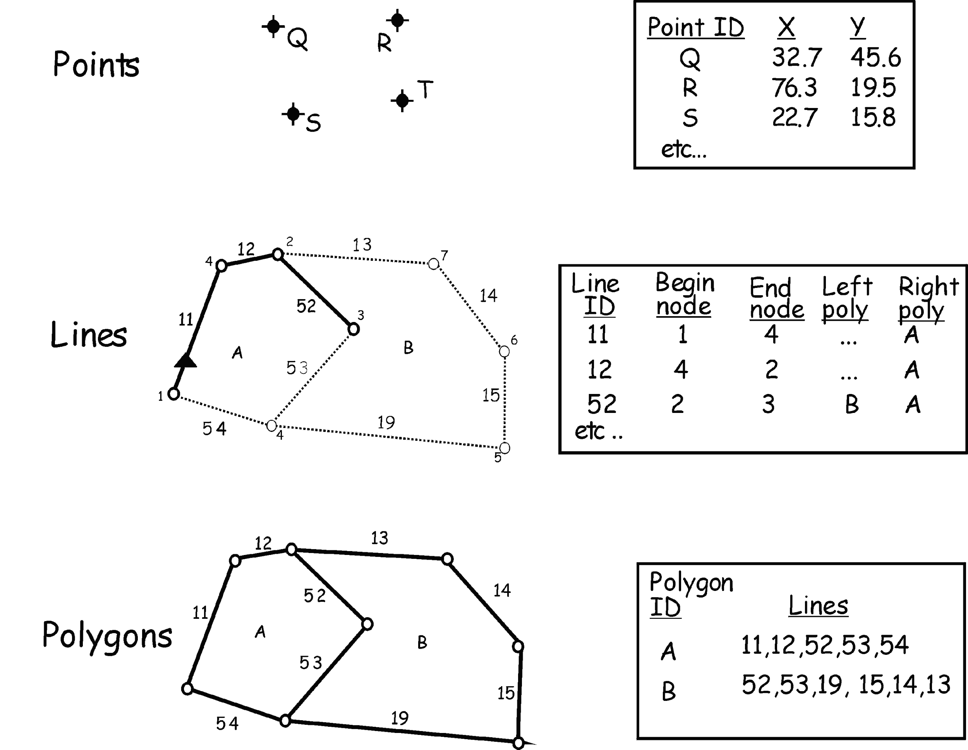
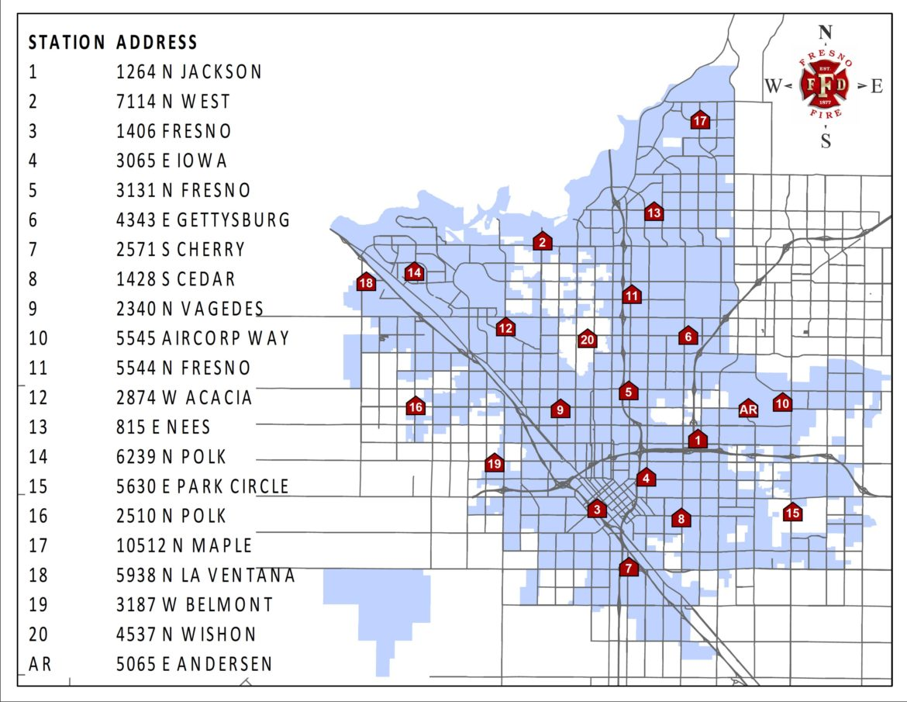
Vector data
https://www.fresno.gov/fire/station-locations/

Slide 4
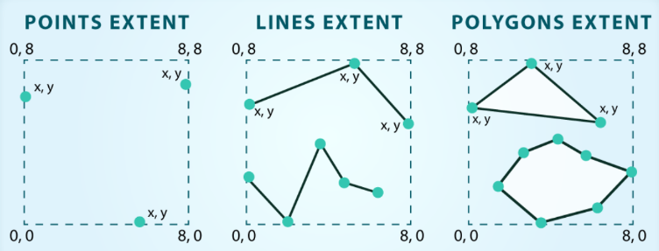
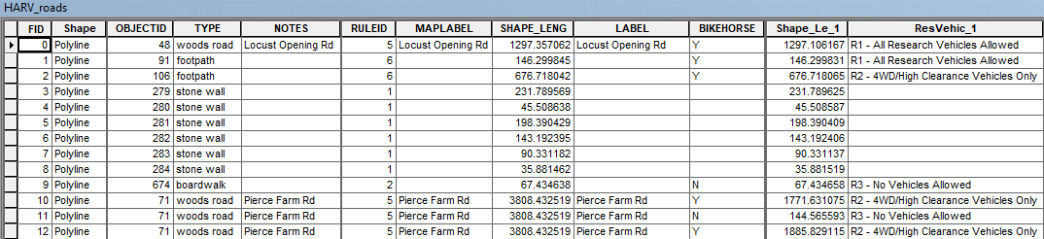
Vector data – metadata & attributes
Metadata:
Spatial extent
File type
Geometry feature type
Coordinate reference system
Other attributes:
Notes:
Vector data has some important advantages:
- The geometry structures hold information in themselves - why choose point over polygon, for instance?
- Each geometry feature can carry multiple attributes instead of just one, e.g. a database of cities can have attributes for name, country, population, etc
Like raster data, vector data can also come in many different formats. For this workshop, we will use the Shapefile format which has the extension .shp. A .shp file stores the geographic coordinates of each vertice in the vector, as well as metadata including:
Extent - the spatial extent of the shapefile (i.e. geographic area that the shapefile covers). The spatial extent for a shapefile represents the combined extent for all spatial objects in the shapefile.
Object type - whether the shapefile includes points, lines, or polygons.
Coordinate reference system (CRS)
Other attributes - for example, a line shapefile that contains the locations of streams, might contain the name of each stream.
Also data source and how to cite it
The downsides of vector data include:
potential bias in datasets - what didn’t get recorded?
Calculations involving multiple vector layers need to do math on the geometry as well as the attributes, so can be slow compared to raster math.

Slide 5
Vector data
File types:
Shapefile (ESRI ArcGIS)
GeoJson
KML /KMZ (Google Earth)
GeoPackage (QGIS)
QGIS can process all these types of files.

Slide 6
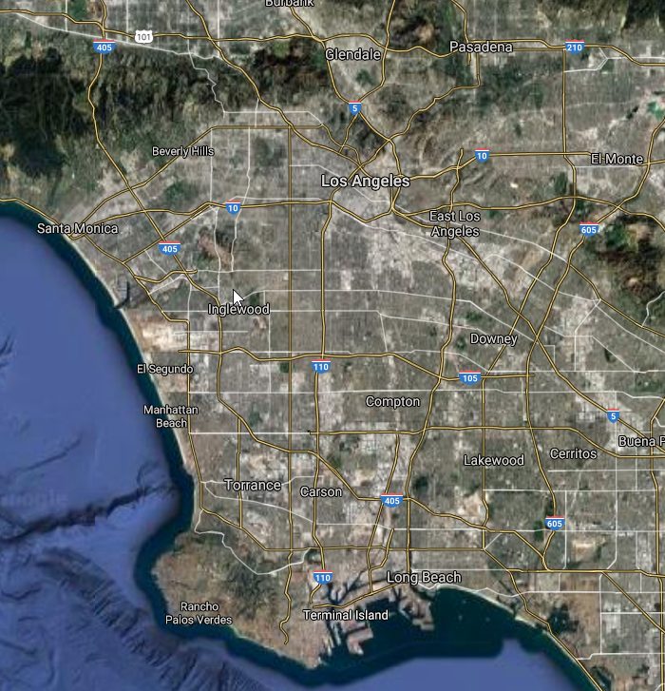
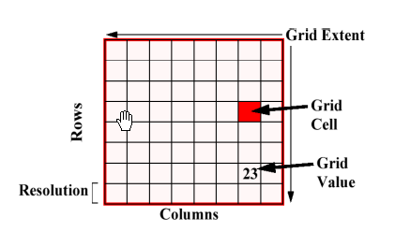
Raster data
File type:
GeoTIFF, JPG
Satellite image

Slide 7
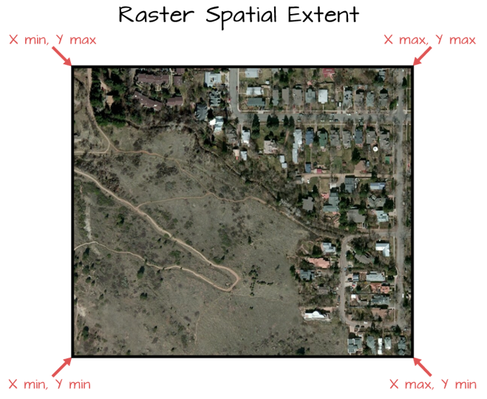
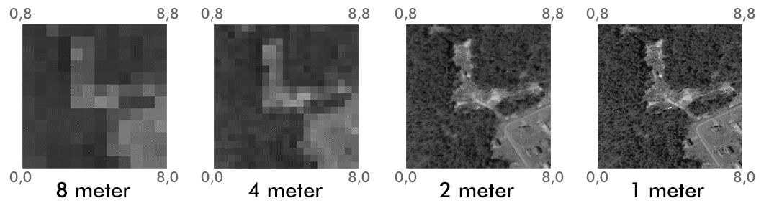
Raster data – attributes
Extent
The spatial resolution of a raster refers to the size of the cells in a raster dataset.
Larger cell size
Low feature spatial accuracy
Smaller file size
Smaller cell size
High feature spatial accuracy
Larger file size
Notes:
Extent
The spatial extent is the geographic area that the raster data covers. The spatial extent of an R spatial object represents the geographic edge or location that is the furthest north, south, east and west. In other words, extent represents the overall geographic coverage.
Resolution
A resolution of a raster represents the area on the ground that each pixel of the raster covers. The image below illustrates the effect of changes in resolution.

Slide 8
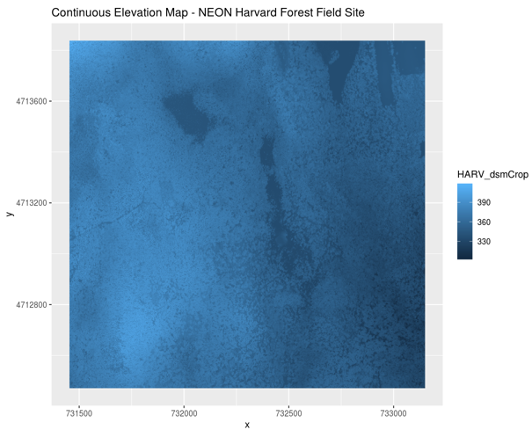
Raster data – continuous
value of a pixel can be continuous (e.g. elevation)
Notes:
Some examples of continuous rasters include:
Precipitation maps
Maps of tree height derived from LiDAR data
Elevation values for a region
A map of elevation for Harvard Forest derived from the NEON AOP LiDAR sensor is below. Elevation is represented as continuous numeric variable in this map. The legend shows the continuous range of values in the data from around 300 to 420 meters.

Slide 9
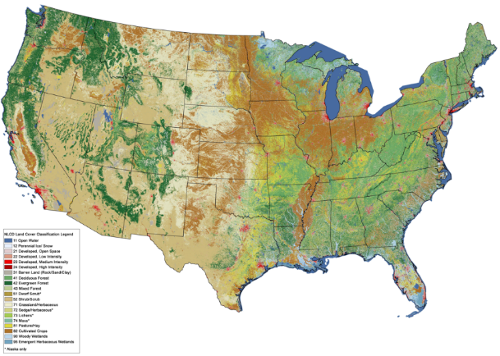
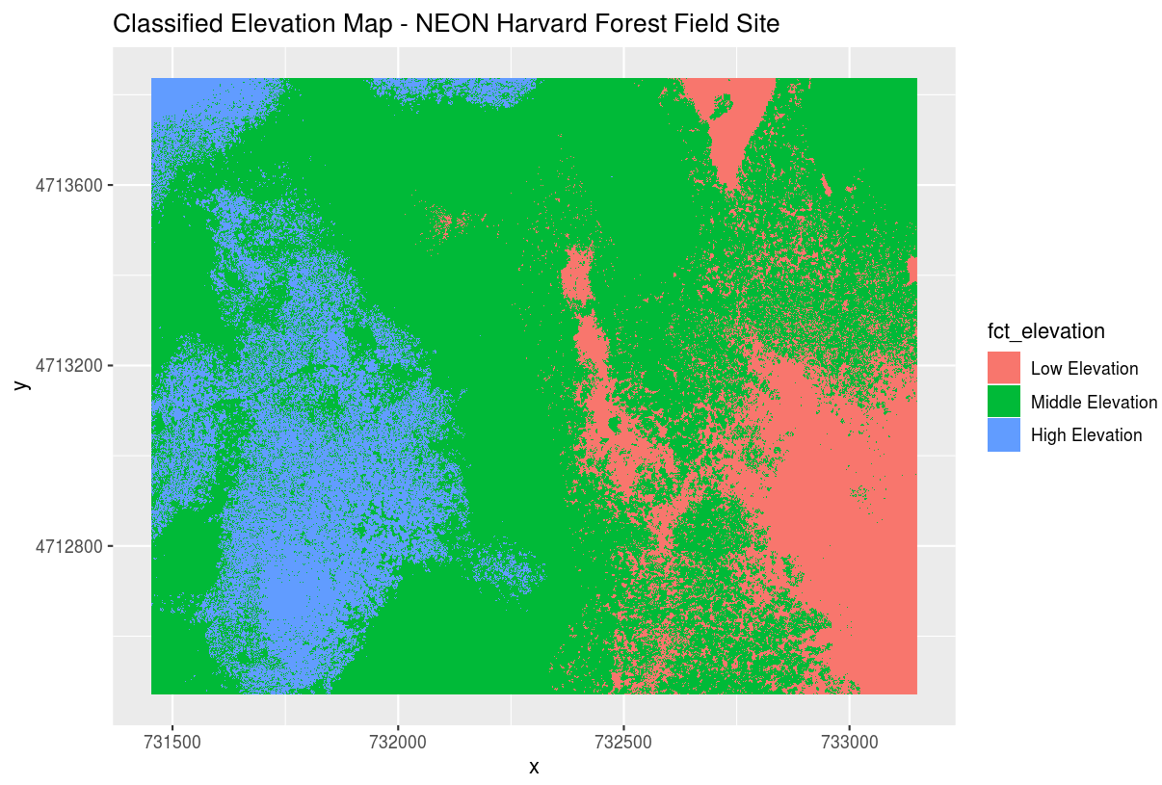
Rster data – categorical
or each pixel can represent
a discrete class such as land cover…
…or elevation
Notes:
Some rasters contain categorical data where each pixel represents a discrete class such as a landcover type (e.g., “forest” or “grassland”) rather than a continuous value.
Some examples of classified maps include:
Landcover / land-use maps. Each color is a different land cover category.
Tree height maps classified as short, medium, and tall trees.
Elevation maps classified as low, medium, and high elevation.
The map above shows elevation data for the NEON Harvard Forest field site. We will be working with data from this site later in the workshop. In this map, the elevation data (a continuous variable) has been divided up into categories to yield a categorical raster.

Slide 10
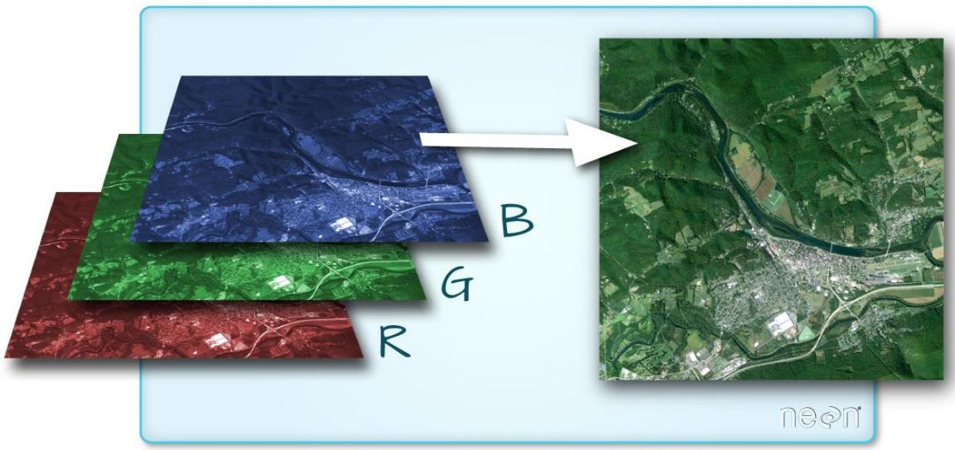
Raster data – multi-band
Notes:
A raster can contain one or more bands. One type of multi-band raster dataset that is familiar to many of us is a color image. A basic color image consists of three bands: red, green, and blue. Each band represents light reflected from the red, green or blue portions of the electromagnetic spectrum.
We can plot each band of a multi-band image individually. The pixel brightness for each band, when composited creates the colors that we see in an image.

Slide 11
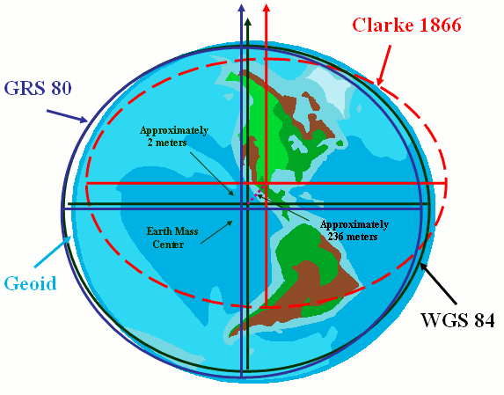
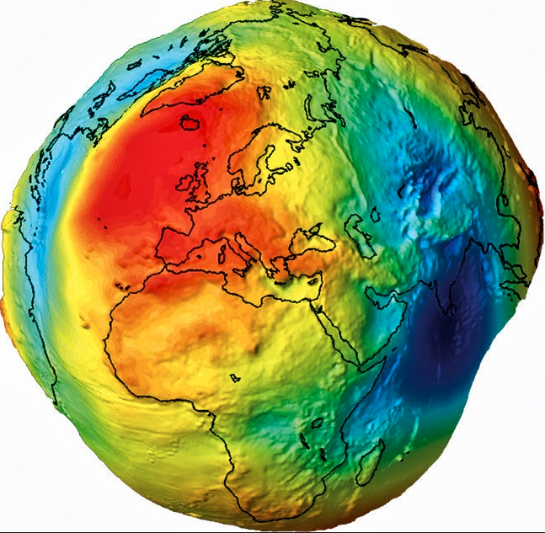
Coordinate reference system- Geodetic datum
Geoid: Earth shape
A geodetic datum is a coordinate system, and a set of reference points, used for locating places on the Earth (or similar objects).

Slide 12

Coordinate reference system- Geodetic datum
A datum is the choice of fruit to use. Is the earth an orange, a lemon, a lime, a grapefruit?

Slide 13
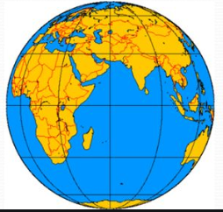
Geodetic datum - WGS84
WGS84 is one of geodetic datums. It is the standard U.S. Department of Defense definition of a global reference system for geospatial information and is the reference system for the Global Positioning System (GPS).
GPS collected data represents locations on the globe.

Slide 14
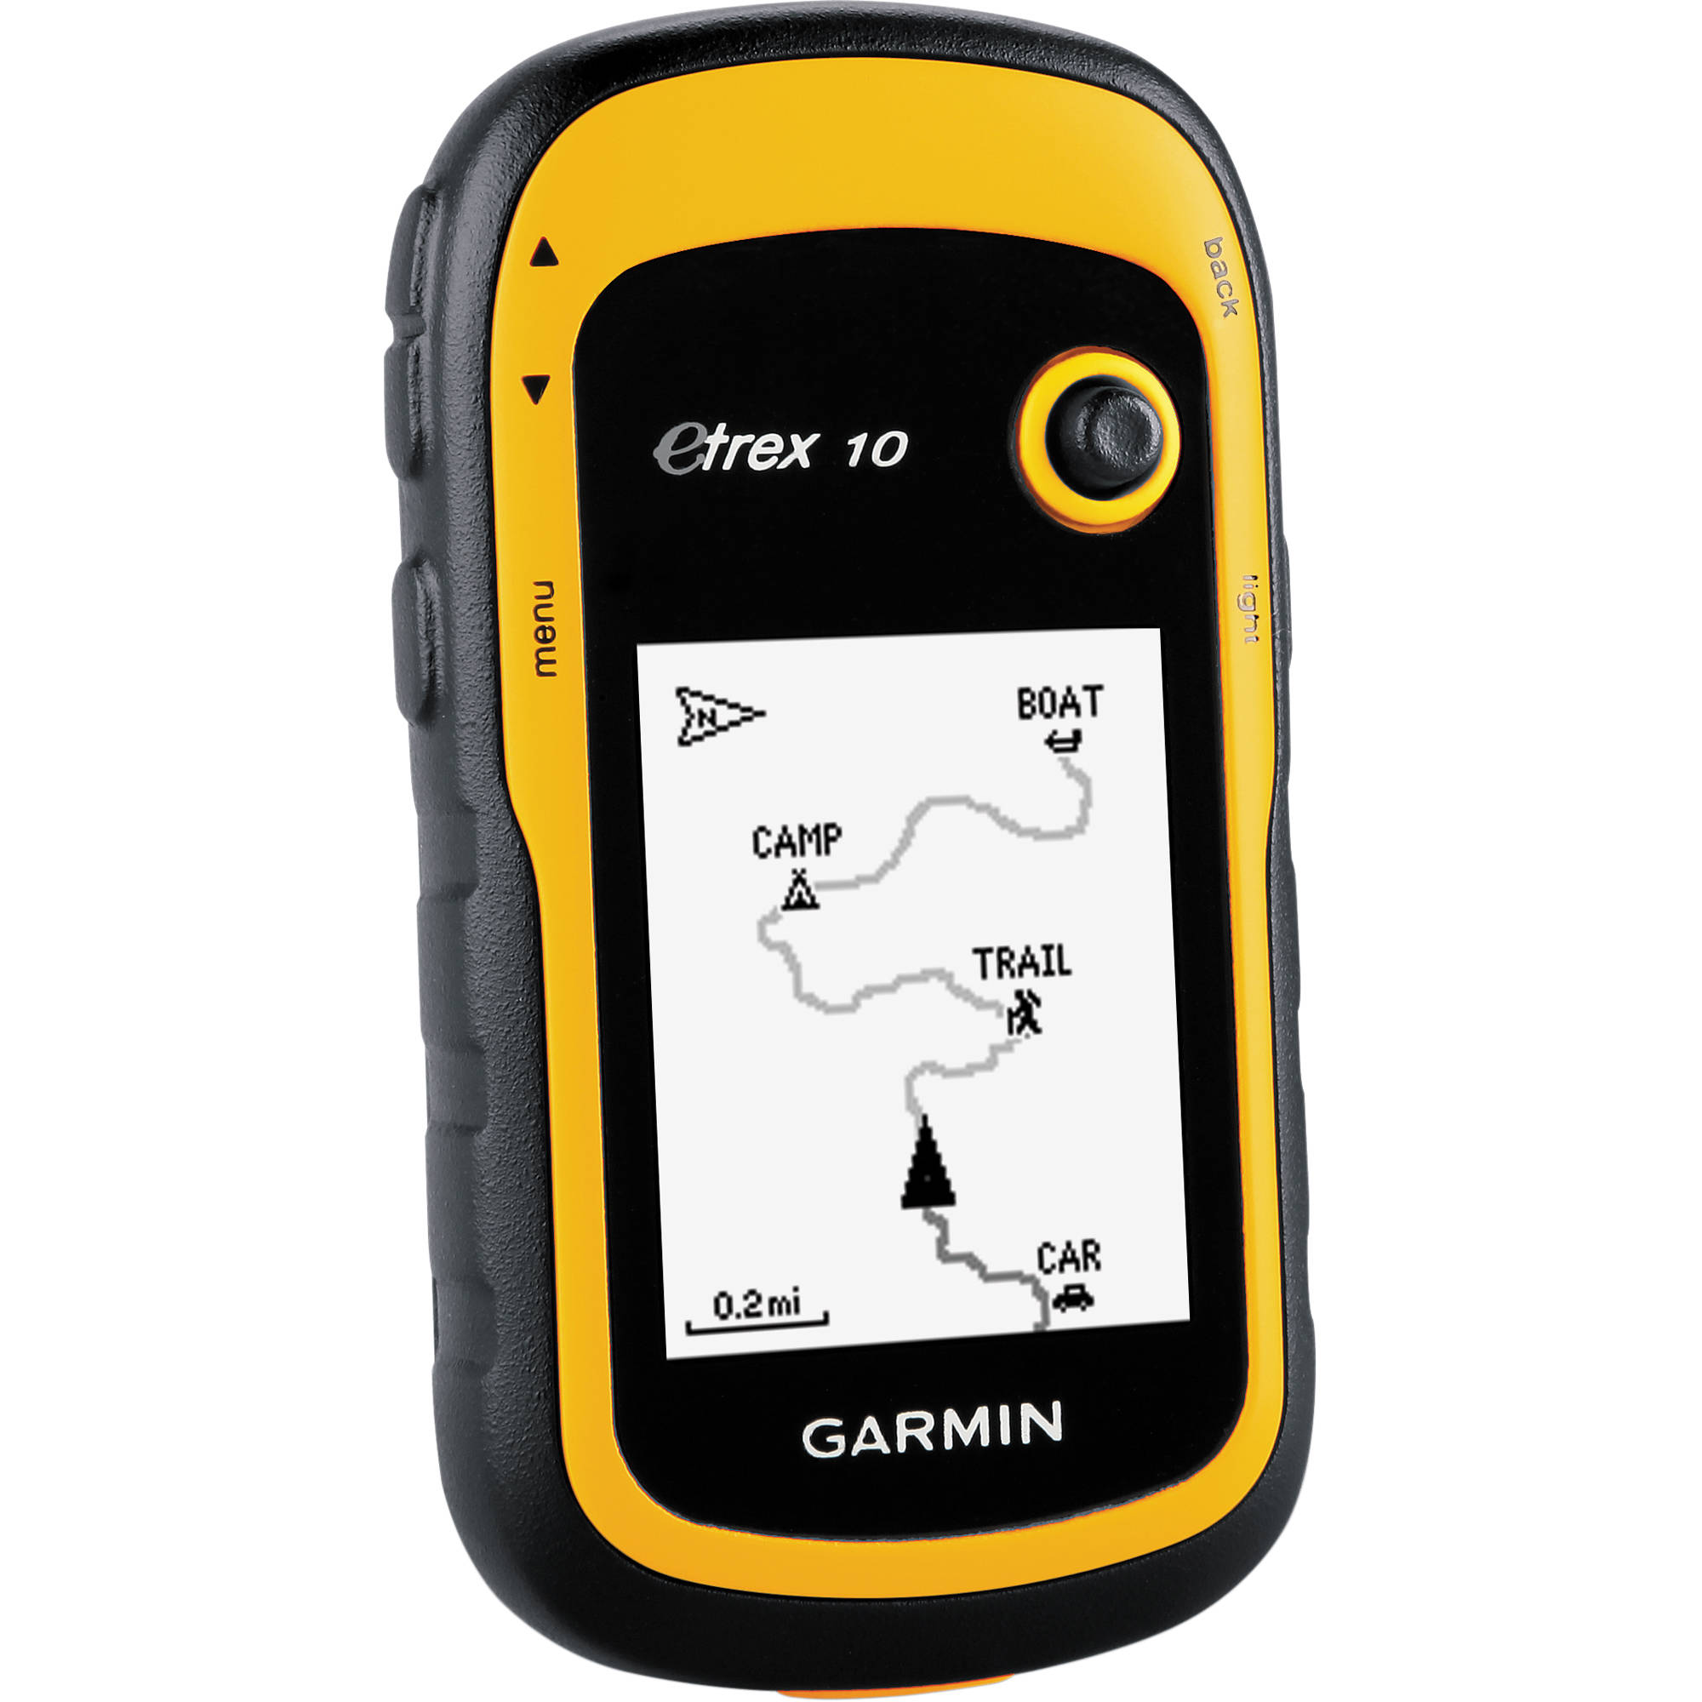
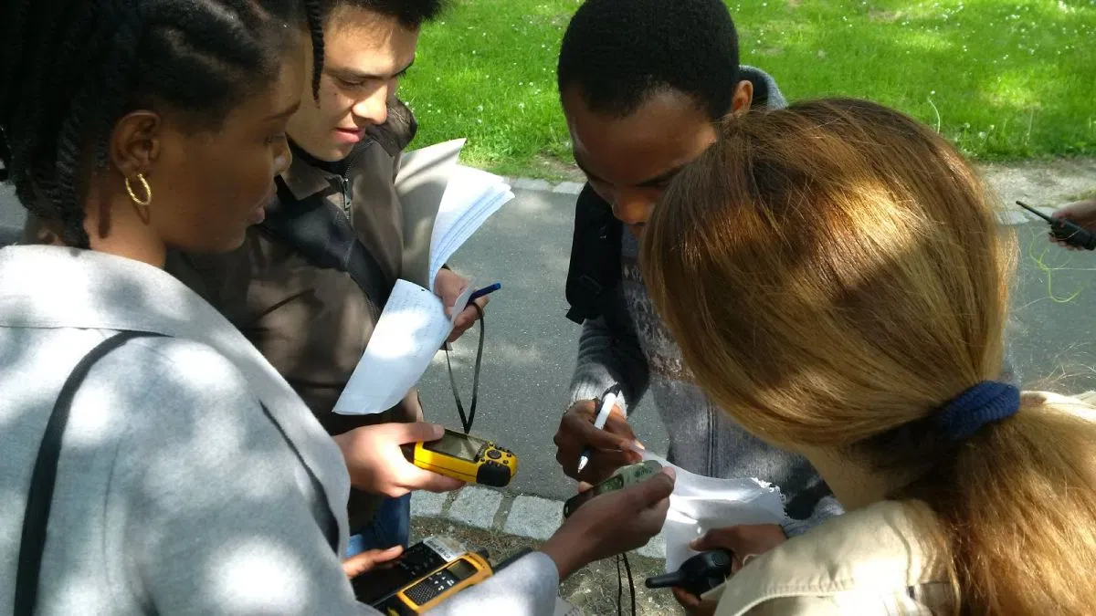
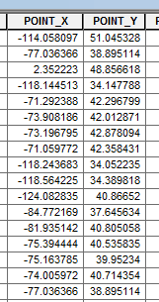
GPS - X and Y Coordinate
X: Longitude
Y: Latitude

Slide 15
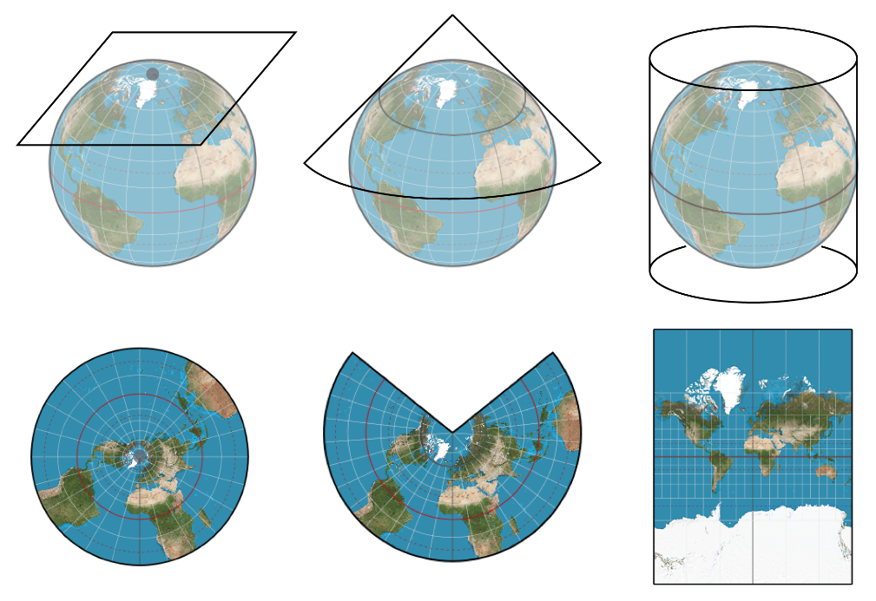
Coordinate reference system- Projection
Flat plan
Cone
Cylinder
A map projection is a way to flatten a globe's surface into a plane in order to make a map.

Slide 16
Coordinate reference system- Projection
X and Y Coordinates are Longitude and Latitude. They represent the locations on the curved surface. We need to project the X and Y coordinates into a flat paper.

Slide 17
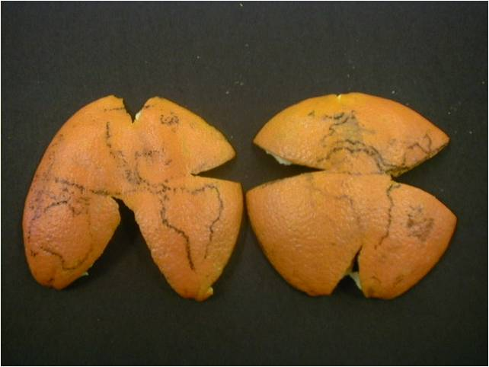
Coordinate reference system- Projection
A projection is how you peel your orange and then flatten the peel.

Slide 18
Coordinate reference system- Projection
A PROJ4 string includes the following information:
proj=: the projection of the data
zone=: the zone of the data (this is specific to the UTM projection)
datum=: the datum use
units=: the units for the coordinates of the data
ellps=: the ellipsoid (how the earth’s roundness is calculated) for the data
Example:
+proj=utm +zone=18 +datum=WGS84 +units=m +no_defs +ellps=WGS84 +towgs84=0,0,0
No default
Parameter values if
transform to WGS

Slide 19

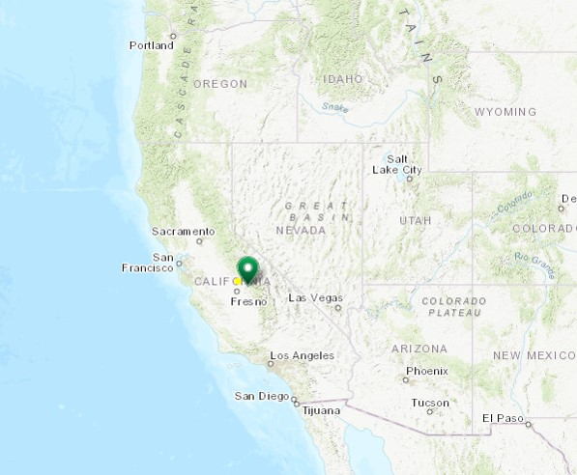
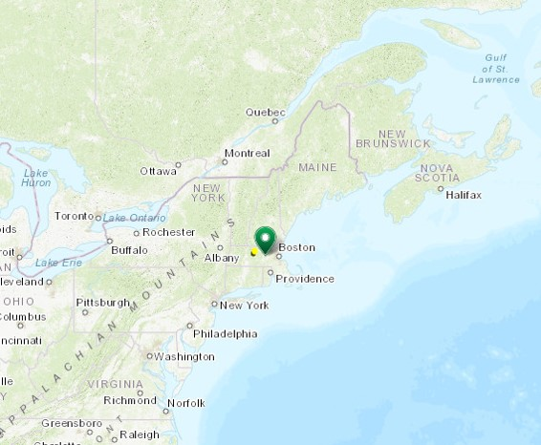
Spatio-temporal data for 2 field sites: National Ecological Observatory Network
San Joaquin Experimental Range (SJER) - California
Harvard Forest (HARV) - Massachusetts
Notes:
First review the data: lots of different files with similar file names
NEON - have 81 field sites in the United States on government areas, marine and terrestrial, i.e. national parks and forests
collect data with standardized methods for about 30 years
purpose of studying ecosystems and how they change over time
make the data publicly available online
Next several slides I’ll introduce the data and the sites, but the Geospatial Workshop Overview setup webpage has all of the information. That’s the page you went to download the data and software, there is a link on the course webpage to that if you want to go back there at any time.

Slide 20

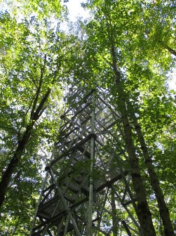
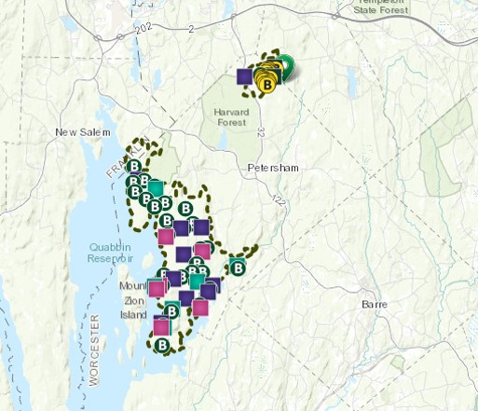
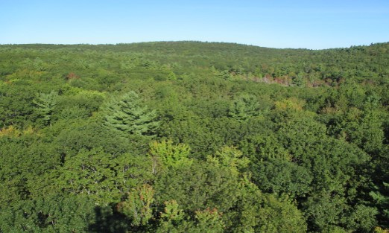
Harvard Forest - HARV
Notes:
On the east coast in Massachusetts – mostly dense forest, lots of precipitation over the year, continental climate with wide temperature range
plots where ecologists collect samples and observational data for soils, plants, insects, birds, microbes
towers where they collect weather data at 6 different elevations from the top of the tree canopy to the ground
also collect remote sensing and spatial data like tower locations, site boundaries
All files for this site start with HARV

Slide 21
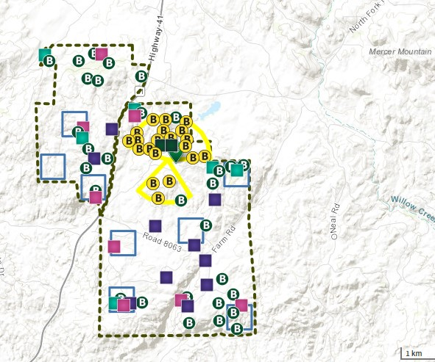
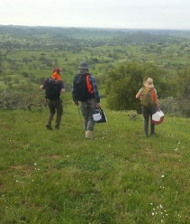
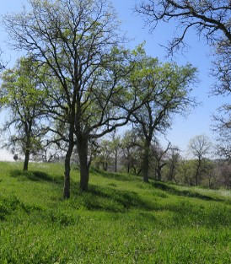
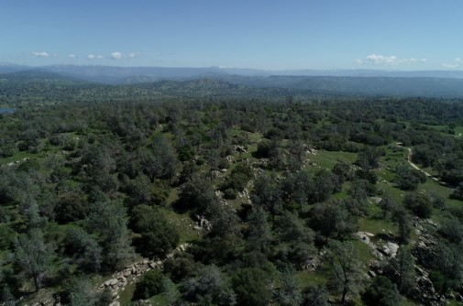
San Joaquin Experimental Range - SJER
Notes:
On the west coast in California – mix of forest and grasslands, much less precipitation and milder/warmer climate
Similar plots for ecological data and towers for meteo data
also collect spatial and remote sensing data but less than at the Harvard Forest site
All files for this site start with SJER

Slide 22
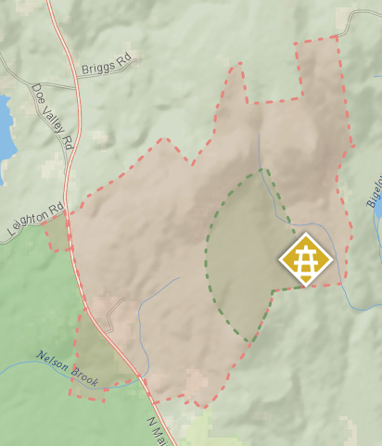
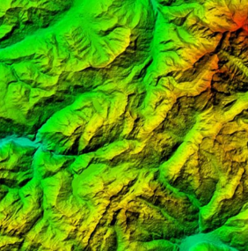

4 types of datasets
Site layout shapefiles
Meteorological time series data
Airborne remote sensing data
Landsat raster images
Notes:
More details on these later
Shapefiles of state boundaries, boundaries of the study areas, points where towers are located
Tables of rainfall, temperature collected at the tower sites
LiDAR: remote sensing data collected from an airplane that is processed to generate models of height of tree canopy, ground elevation
Landstat: satellite images collected from space

Slide 23
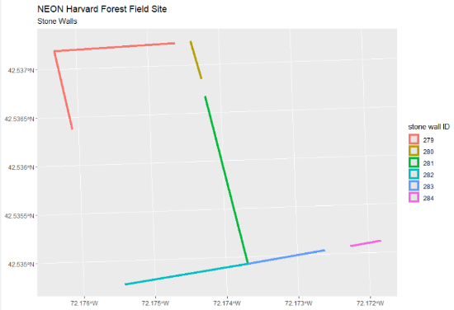
2 datasets (HARV only)
NEON-DS-Met-Time-Series
Meteorological data: precip, temp, day length
Format: text/tabular
NEON-DS-Site-Layout-Files
Spatial data: boundaries, plot locations, roads
Format: shapefiles/vector
 | datetime | jd | airt | f.airt | rh | f.rh | dewp | f.dewp | prec | f.prec | slrr | f.slrr | parr
140255 | 1/1/2009 0:00 | 366 | -17.3 |  | 76 |  | -20.6 |  | 0 |  | 0 |  | 0
140256 | 1/1/2009 0:15 | 1 | -17.4 |  | 75 |  | -20.8 |  | 0 |  | 0 |  | 0
140257 | 1/1/2009 0:30 | 1 | -17.5 |  | 75 |  | -21 |  | 0 |  | 0 |  | 0
140258 | 1/1/2009 0:45 | 1 | -17.6 |  | 75 |  | -21.1 |  | 0 |  | 0 |  | 0
140259 | 1/1/2009 1:00 | 1 | -17.8 |  | 75 |  | -21.1 |  | 0 |  | 0 |  | 0
140260 | 1/1/2009 1:15 | 1 | -17.8 |  | 74 |  | -21.3 |  | 0 |  | 0 |  | 0
140261 | 1/1/2009 1:30 | 1 | -17.9 |  | 74 |  | -21.4 |  | 0 |  | 0 |  | 0
140262 | 1/1/2009 1:45 | 1 | -18 |  | 74 |  | -21.5 |  | 0 |  | 0 |  | 0
140263 | 1/1/2009 2:00 | 1 | -18 |  | 73 |  | -21.6 |  | 0 |  | 0 |  | 0
140264 | 1/1/2009 2:15 | 1 | -18.1 |  | 73 |  | -21.7 |  | 0 |  | 0 |  | 0
140265 | 1/1/2009 2:30 | 1 | -18.2 |  | 73 |  | -21.8 |  | 0 |  | 0 |  | 0
140266 | 1/1/2009 2:45 | 1 | -18.3 |  | 73 |  | -21.9 |  | 0 |  | 0 |  | 0
140267 | 1/1/2009 3:00 | 1 | -18.4 |  | 72 |  | -22.2 |  | 0 |  | 0 |  | 0
140268 | 1/1/2009 3:15 | 1 | -18.4 |  | 70 |  | -22.5 |  | 0 |  | 0 |  | 0
140269 | 1/1/2009 3:30 | 1 | -18.4 |  | 68 |  | -22.8 |  | 0 |  | 0 |  | 0
Notes:
Zip file that you downloaded contains 4 folders with the 4 different types of data
2 of the 4 have a folder each for the 2 sites; 2 only have data for HARV
Site layout shapefiles: NEON-DS-Site-Layout-Files.zip: A set of shapefiles for the NEON's Harvard Forest field site and US and (some) state boundary layers.
Spatial data files that show boundaries of the HARV study area or plot or tower locations where measurements and samples were taken.
Will mostly work with these tomorrow.
Meteorological data: NEON-DS-Met-Time-Series.zip: Precipitation, temperature and other variables collected from a flux tower at the NEON Harvard Forest site.

Slide 24

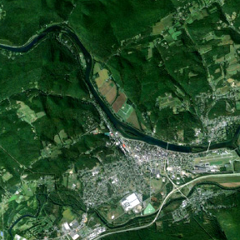
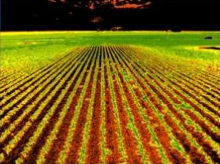
NEON-DS-Landsat-NDVI (HARV & SJER)
NDVI
Normalized difference vegetation index
Format: raster GeoTIFF
RBG
Georeferenced aerial photograph
Format: raster GeoTIFF
Notes:
NEON-DS-Landsat-NDVI
One folder for each field site and then within each there several files, but there are 2 types of data: NDVI and RGB
Data are in raster GeoTIFF files which are just one kind of file format used with geospatial data. [Geographic Tagged Image-File Format]
Remote sensing data from images that have been:
collected by a Landsat satellite from space
Processed by USGS and georeferenced, meaning that they contain spatial info so that they can be related to a coordinate system on the ground and to other spatial data.
#1
NDVI: derived from images and shows quantity of vegetation of the landcover
low values = sand, snow, dirt (red); mid values = grassland; high values = forested (green)
#2
RGB: aerial photograph that has been georeferenced.
It is called RGB because it has red, green and blue layers which displayed together make a full color image

Slide 25

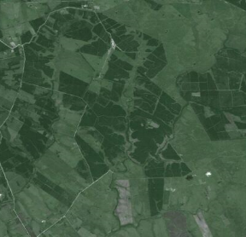
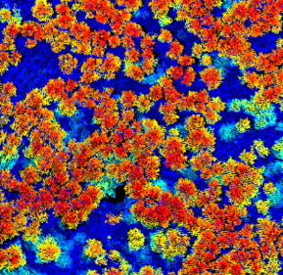
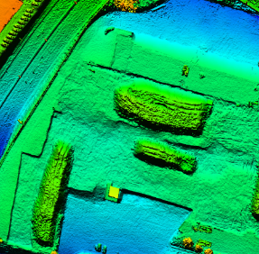
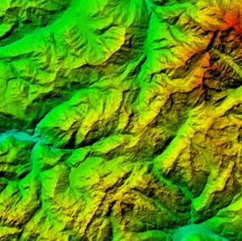
NEON-DS-Airborne-Remote-Sensing (HARV & SJER)
NEON - Airborne Observation Platform (AOP)
RGB_imagery
aerial photography
CHM
canopy height model
DSM
digital surface model
DTM
digital terrain model
Notes:
NEON-DS-Airborne-Remote-Sensing
One folder for each field site and then within each there are 2 (SJER) & 4 folders (HARV) containing different types of raster data.
Also raster data stored as .tif files containing spatial information
These data are collected and processed directly by NEON - Airborne Observation Platform (AOP) so collected with instruments on an airplane rather than a satellite
LiDAR remote sensing data (light imaging, detection, and ranging) and digital photography
RGB_imagery = aerial photography similar to that collected with the global Landsat satellite that is in the Landsat data folder
CHM = canopy height model – maps the tree height as a continuous surface over the underlying ground topography
DSM = digital surface model – captures natural and built features on the Earth’s surface like power lines, buildings, vegetation
DTM = digital terrain model – captures only bare earth with all non-ground points filtered out. Used when you need to know topography or ground elevation.
1-m spatial resolution
Fly continuously all summer and cover about 75% of field sites areas

Slide 26
Geospatial concepts
Geospatial data
Vector data: points, line, polygon
Raster data: pixel with values
Coordinate reference system (CRS)
Geodetic datum
Projection
Data for this workshop: NEON

Slide 27
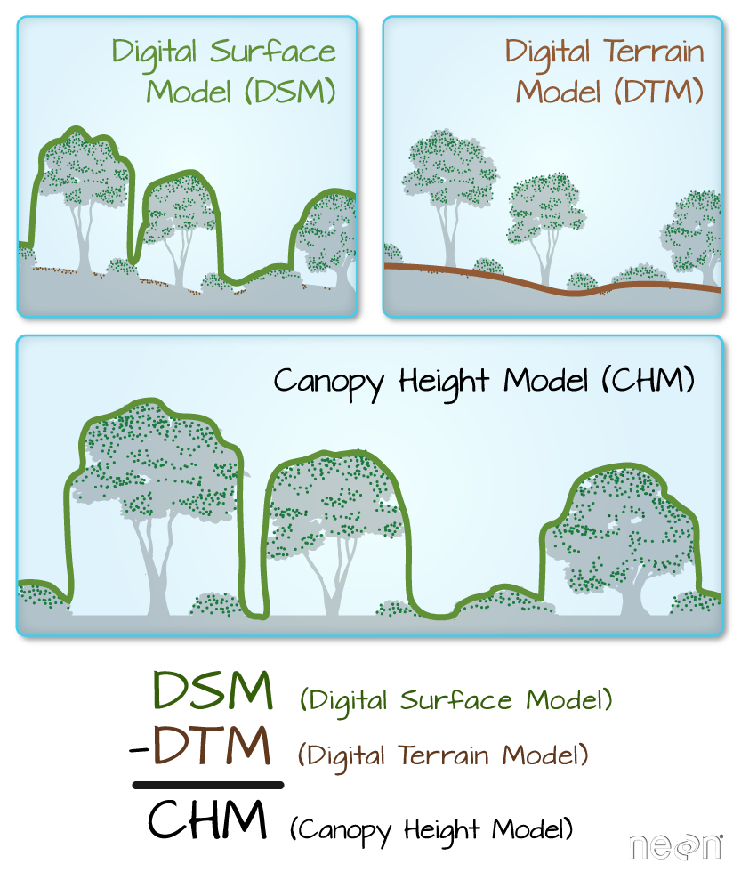
Raster Calculation

